Slide 1
VFC 400 Vaccine Monitoring Data Logger kit Step 2 VTMC Software Download
Presented by
Control Solutions
(503) 410-5996
Slide 1

Slide 2
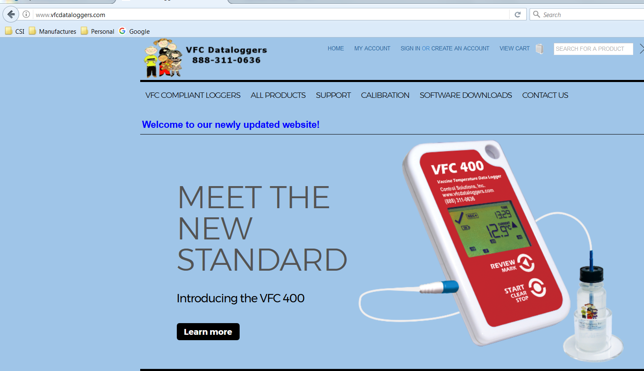
VFC 400 software download
From the internet, go to our website www.vfcdataloggers.com to download the latest software revision.
Click on Software Downloads and then click on “VFC400 software download”
Slide 2
Notes:
Lesson descriptions should be brief.

Slide 3
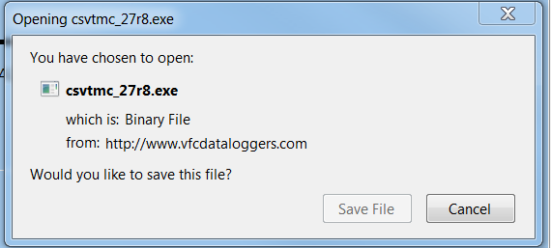
VFC 400 software download
Scroll down and click on “Click to Download”
When the box shows up as shown below, click on “Save File”.
Slide 3
Notes:
Lesson descriptions should be brief.

Slide 4
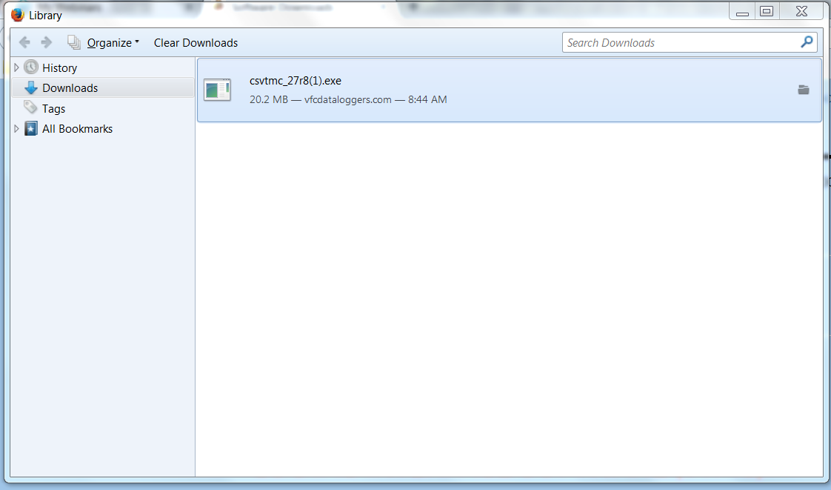
VFC 400 software download
Go to where you saved the file to and click on the file to start the download. You will need administration rights to do this and may need IT support.
The file is saved as a zip file. Double click on the zip file and then double click on file “csvtmc_27r8.exe”
Slide 4
Notes:
Lesson descriptions should be brief.

Slide 5
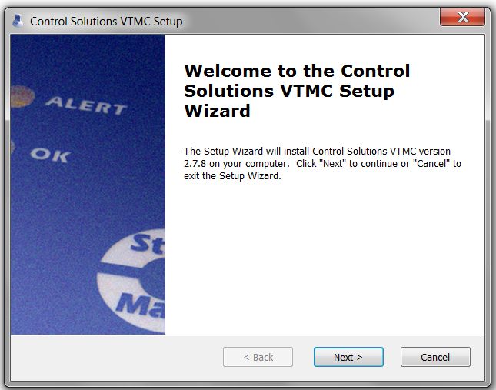
VFC 400 software download
A pop-up will appear that asks “Do you want to allow the following program to make changes to this computer?”. Click yes.
The next series of pop-ups click as shown by the arrows
Slide 5
Notes:
Lesson descriptions should be brief.

Slide 6
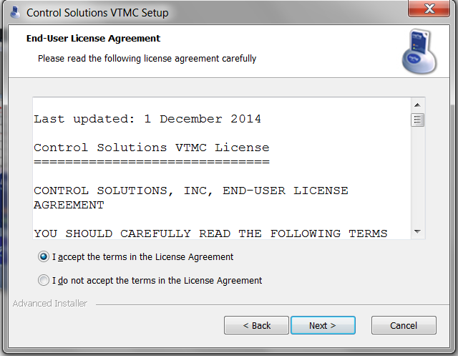
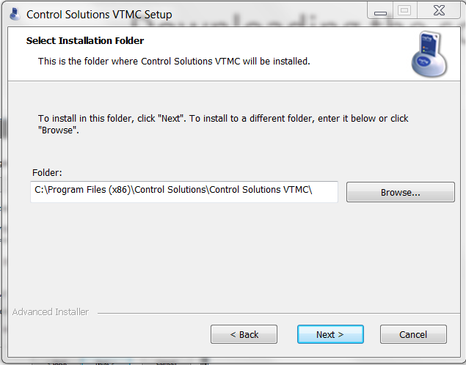
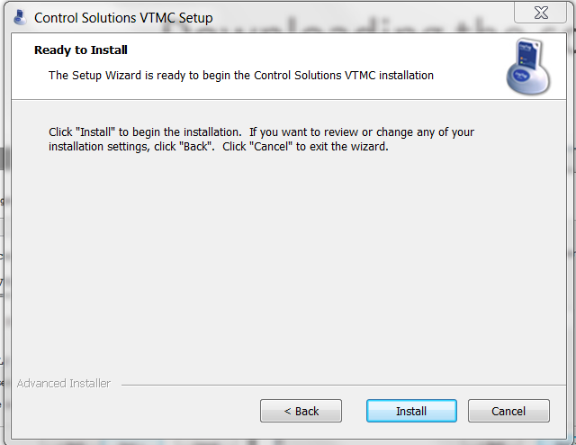
VFC 400 software download
Slide 6
Notes:
Lesson descriptions should be brief.

Slide 7
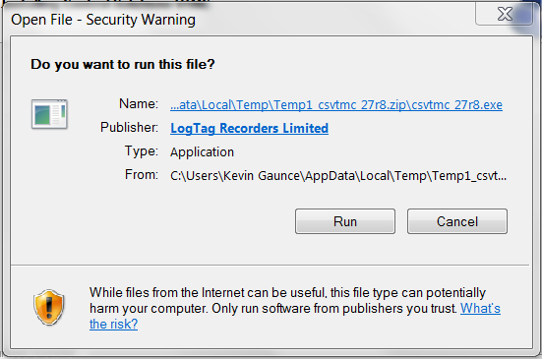
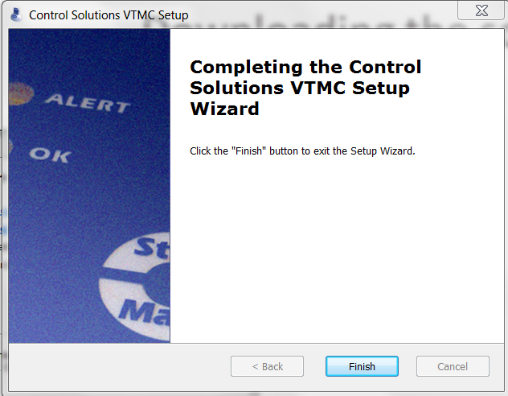
VFC 400 software download
Slide 7
Notes:
Lesson descriptions should be brief.

Slide 8
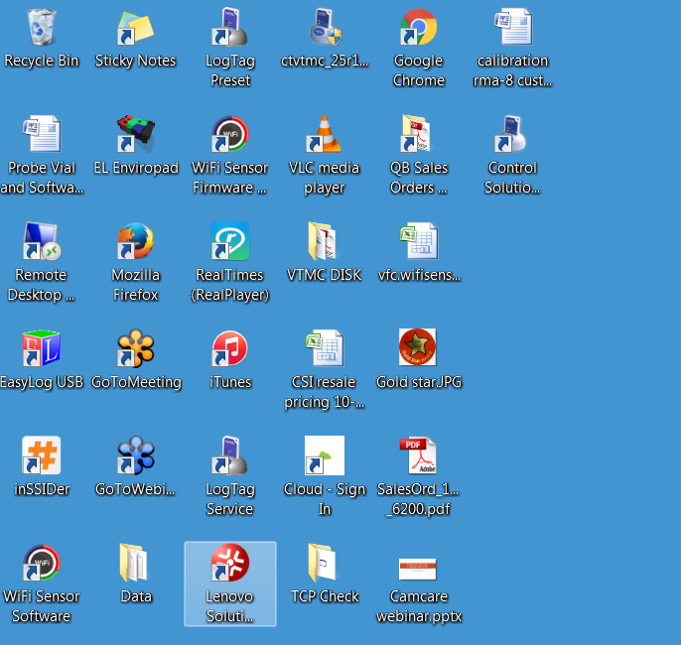
VFC 400 software download
You should now have an icon on your desktop that looks like this.
Slide 8
Notes:
Lesson descriptions should be brief.

